Slide 1

TensorFlow & Ray
From Supervised Learning
to Reinforcement Learning
EECS 598-009
2019-02-06 By Peifeng Yu

Slide 2
Deep Learning Becomes Ubiquitous
Computer vision
Natural language processing
Speech
Robotics
Applications
Intelligent assistant: Google Now, Siri, Cortana
Face recognition
Video content understanding
Notes:
- Familiar with DL

Slide 3
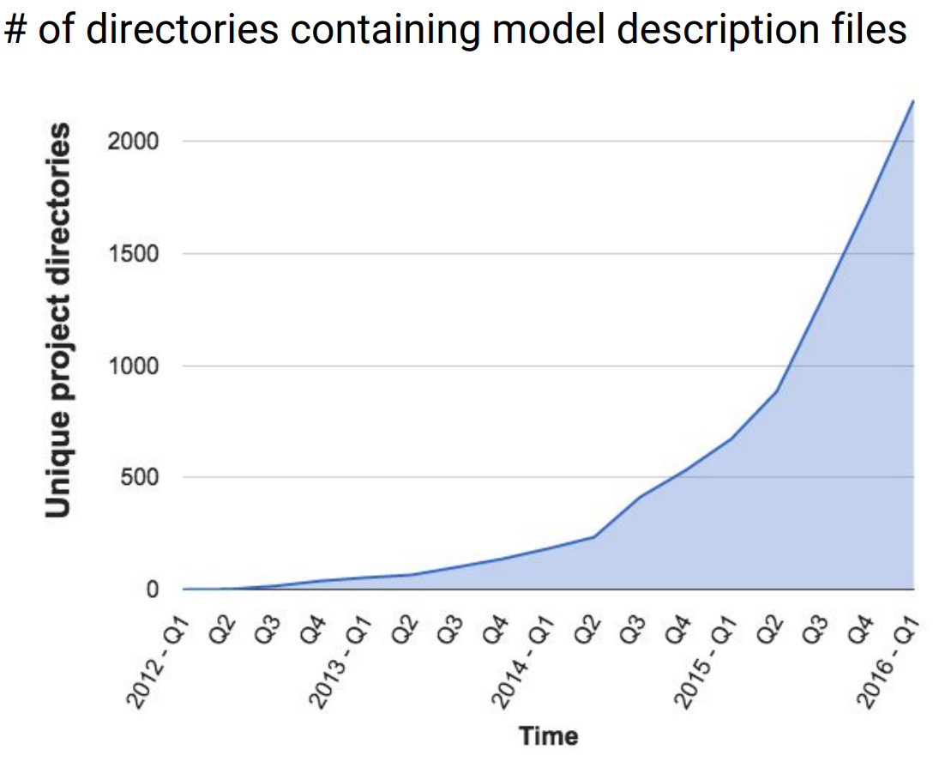
Deep Learning Becomes Ubiquitous
Growing Use of Deep Learning at Google
Figures adapted from Jeff Dean “Large-Scale Deep Learning with Tensorflow”
Notes:
- Familiar with DL

Slide 4
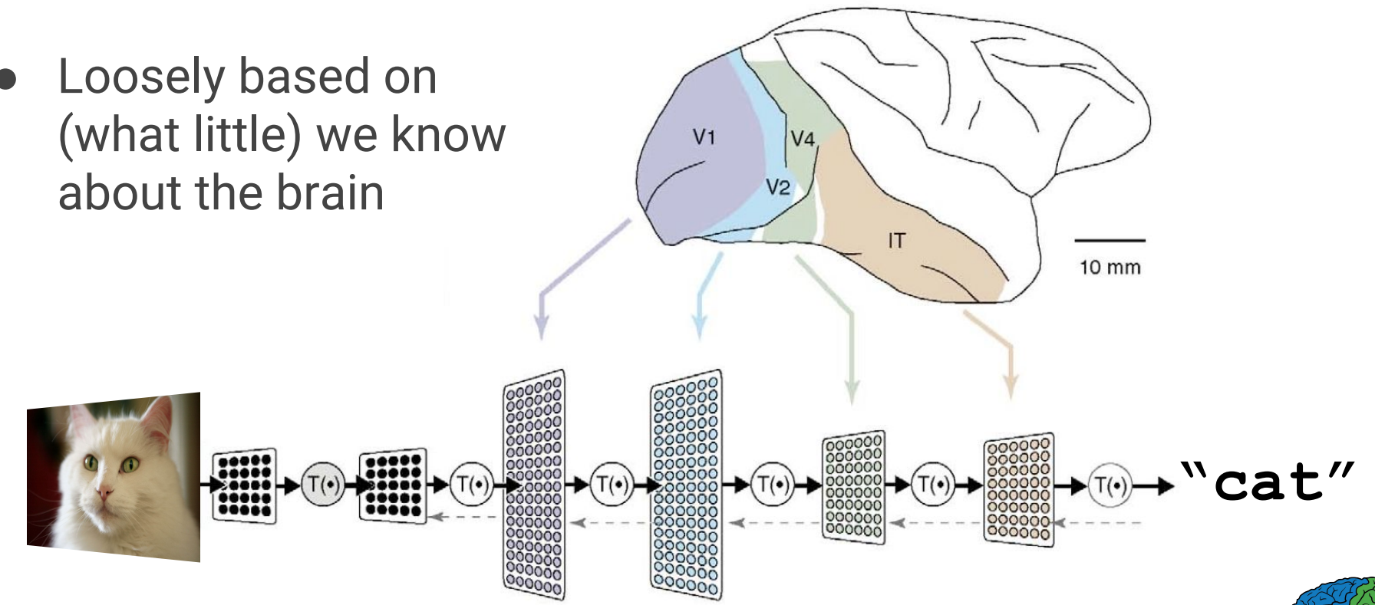
A Brief Introduction to Deep Learning
A powerful class of machine learning model
Modern reincarnation of artificial neural networks
Collection of simple, trainable mathematical functions
Compatible with many variants of machine learning
Adapted from Jeff Dean “Large-Scale Deep Learning with Tensorflow”
Notes:
A kind of machine learning model
Modern reincarnation of artificial neural networks
Collection of simple trainable mathematical functions
Compatible with many variants of machine learning

Slide 5



A Brief Introduction to Deep Learning
Training:
Errors
Dog
Cat
Raccoon
✔
✔
✗
Notes:
A kind of machine learning model
Modern reincarnation of artificial neural networks
Collection of simple trainable mathematical functions
Compatible with many variants of machine learning

Slide 6

A Brief Introduction to Deep Learning
Inference:
Cat
✔
Notes:
- Familiar with DL

Slide 7
Why TensorFlow?
Large scale training
Low latency serving (inference)
Research

Slide 8
Why TensorFlow?
Large scale training
Important Property of Neural Networks
Results get better with
more data +
bigger models +
more computation
Adapted from Jeff Dean “Large-Scale Deep Learning with Tensorflow”

Slide 9
Why TensorFlow?
Existing solutions (at that time)
Framework | Distributed Training | Serving | Flexibility | Model
DistBelief | Yes | No | No | Layer
Caffe | No | No | No | Layer
Theano | No | No | Yes | Operator
Torch | No | No | Yes | Operator (Imperative)
Notes:
We will review new frameworks at discussion time

Slide 10
Previous system: DistBelief
Distributed system for training neural networks
Parameter server architecture
Programming model: DAG of layers with a loss function
Limitations
Defining new layers
Refining the training algorithms
Defining new training algorithms
Deep Learning Frameworks
Notes:
Refining: the interface for PS is not ideal for all optimization methods
Defining new training: simulator/emulator, adversarial networks, reinforcement learning

Slide 11
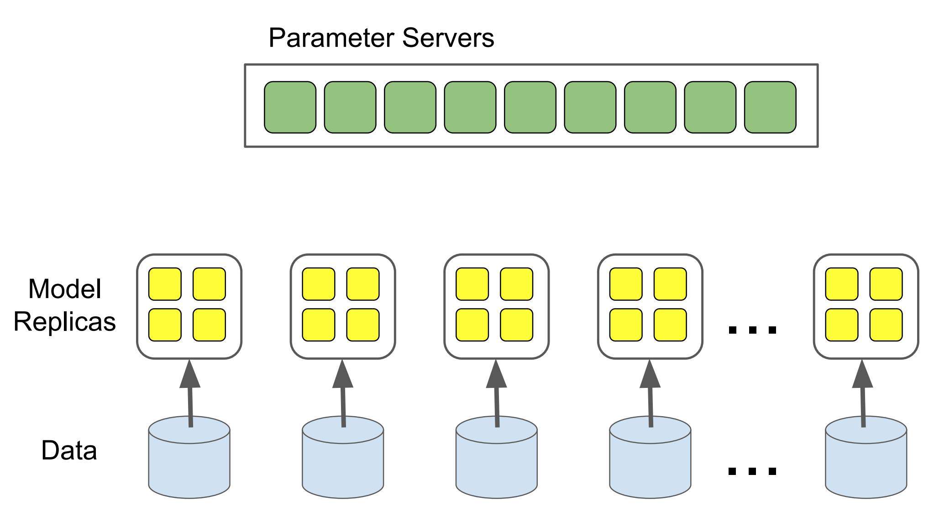
Previous system: DistBelief
Deep Learning Frameworks
Adapted from Jeff Dean “Large-Scale Deep Learning with Tensorflow”
Notes:
Refining: the interface for PS is not ideal for all optimization methods
Defining new training: simulator/emulator, adversarial networks, reinforcement learning

Slide 12

Previous system: DistBelief
Deep Learning Frameworks
Adapted from Jeff Dean “Large-Scale Deep Learning with Tensorflow”
Notes:
Refining: the interface for PS is not ideal for all optimization methods
Defining new training: simulator/emulator, adversarial networks, reinforcement learning

Slide 13
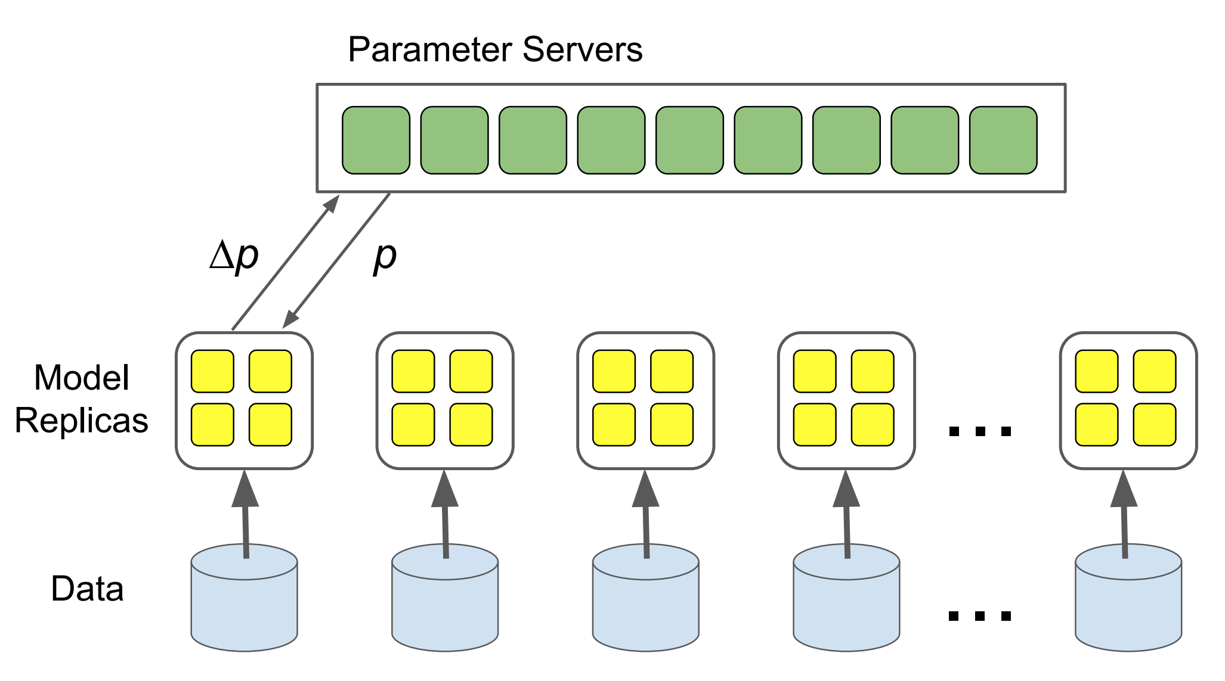
Previous system: DistBelief
Deep Learning Frameworks
Adapted from Jeff Dean “Large-Scale Deep Learning with Tensorflow”
Notes:
Refining: the interface for PS is not ideal for all optimization methods
Defining new training: simulator/emulator, adversarial networks, reinforcement learning

Slide 14

Previous system: DistBelief
Deep Learning Frameworks
Adapted from Jeff Dean “Large-Scale Deep Learning with Tensorflow”
Notes:
Refining: the interface for PS is not ideal for all optimization methods
Defining new training: simulator/emulator, adversarial networks, reinforcement learning

Slide 15

Previous system: DistBelief
Deep Learning Frameworks
Adapted from Jeff Dean “Large-Scale Deep Learning with Tensorflow”
Notes:
Refining: the interface for PS is not ideal for all optimization methods
Defining new training: simulator/emulator, adversarial networks, reinforcement learning

Slide 16
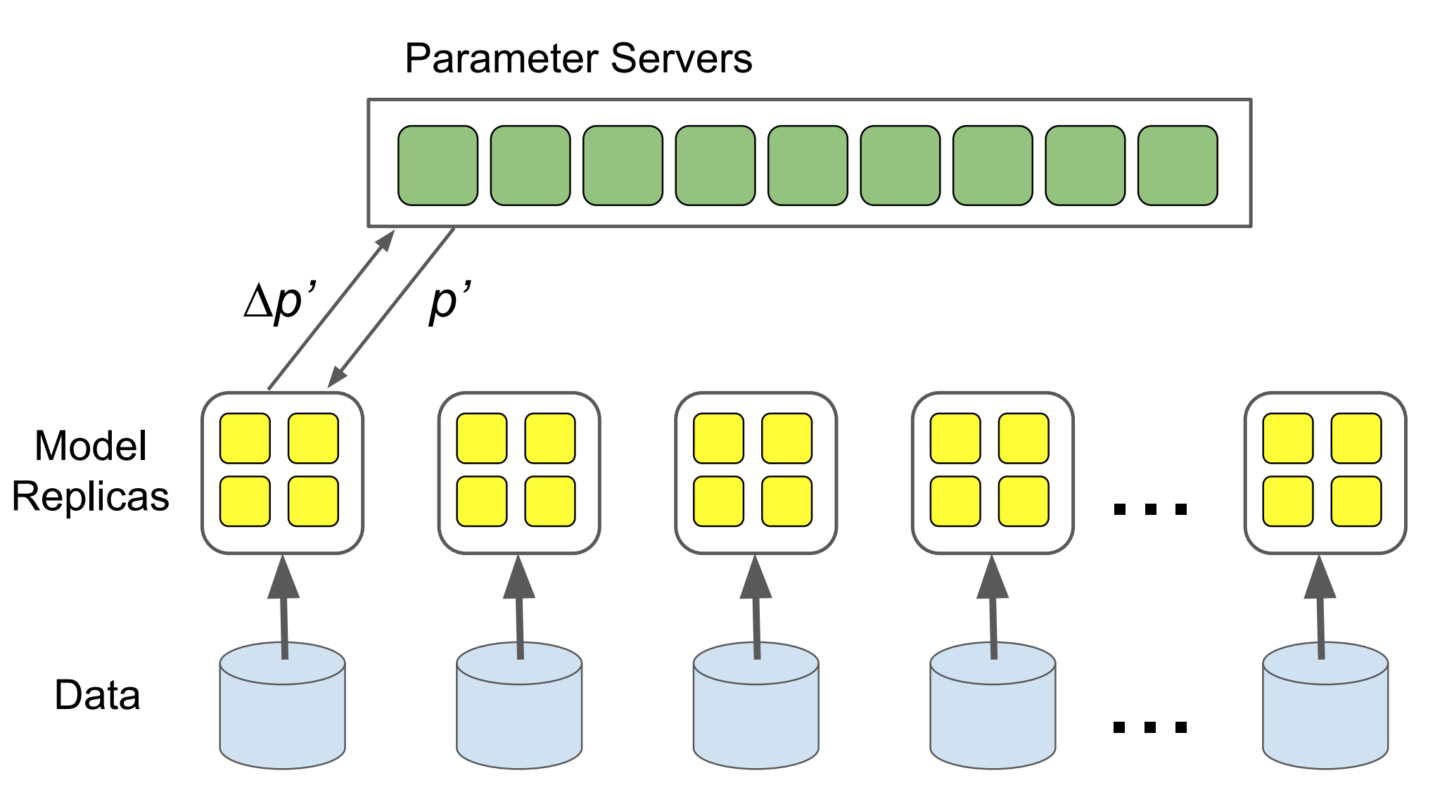
Previous system: DistBelief
Deep Learning Frameworks
Adapted from Jeff Dean “Large-Scale Deep Learning with Tensorflow”
Notes:
Refining: the interface for PS is not ideal for all optimization methods
Defining new training: simulator/emulator, adversarial networks, reinforcement learning

Slide 17
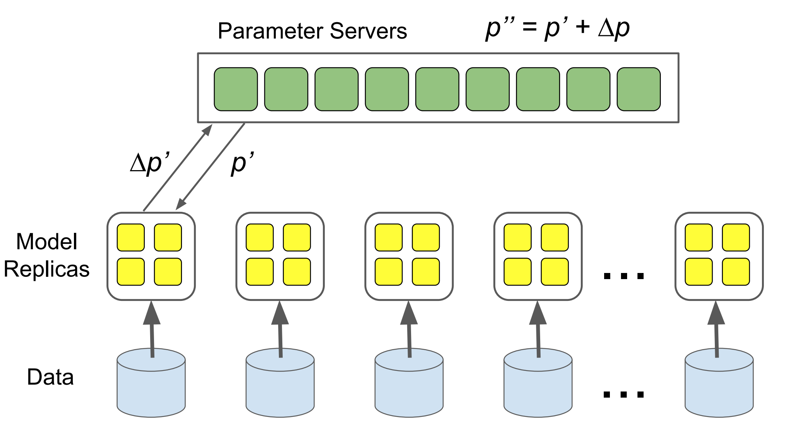
Previous system: DistBelief
Deep Learning Frameworks
Adapted from Jeff Dean “Large-Scale Deep Learning with Tensorflow”
Notes:
Refining: the interface for PS is not ideal for all optimization methods
Defining new training: simulator/emulator, adversarial networks, reinforcement learning

Slide 18

Previous system: DistBelief
Deep Learning Frameworks
Adapted from Jeff Dean “Large-Scale Deep Learning with Tensorflow”
Notes:
Refining: the interface for PS is not ideal for all optimization methods
Defining new training: simulator/emulator, adversarial networks, reinforcement learning

Slide 19
Design Principles
Dataflow graphs of primitive operators
Deferred execution
Common abstraction for heterogeneous accelerators
Deep Learning Frameworks
Notes:
Refining: the interface for PS is not ideal for all optimization methods
Defining new training: simulator/emulator, adversarial networks, reinforcement learning

Slide 20
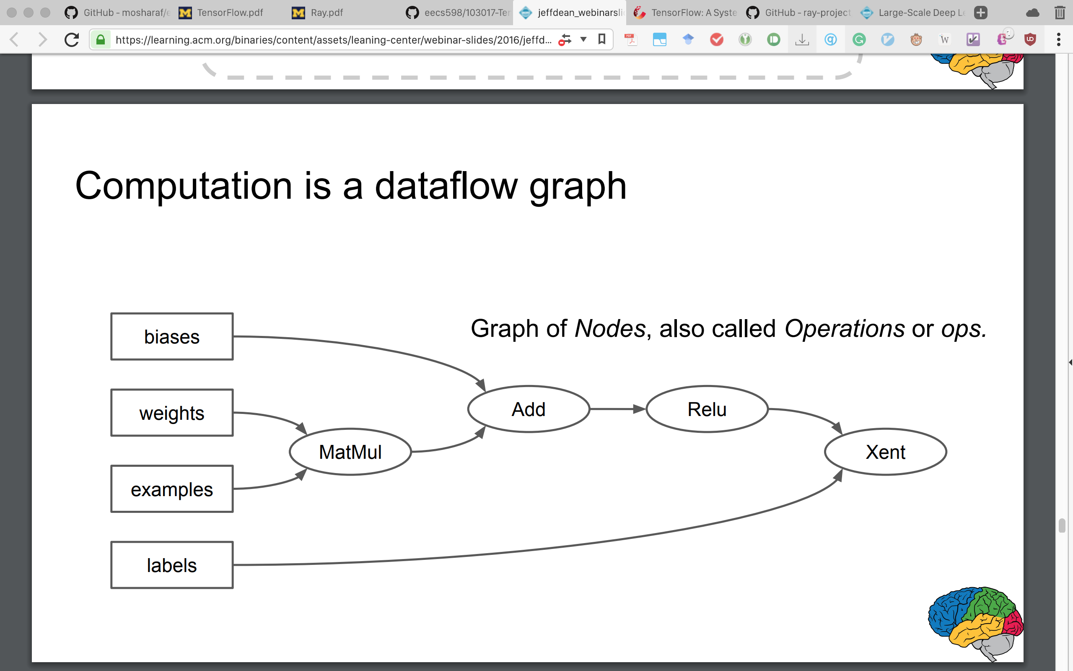
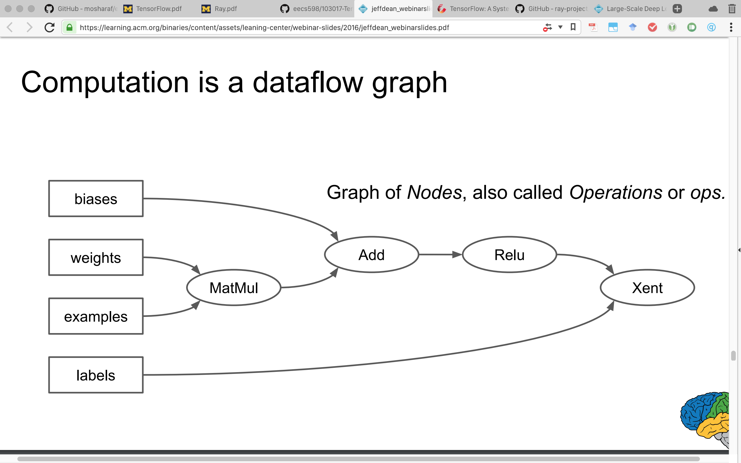
Dataflow Graph
Computation is a dataflow graph
Deep Learning Frameworks
Adapted from Jeff Dean “Large-Scale Deep Learning with Tensorflow”
Notes:
Refining: the interface for PS is not ideal for all optimization methods
Defining new training: simulator/emulator, adversarial networks, reinforcement learning

Slide 21
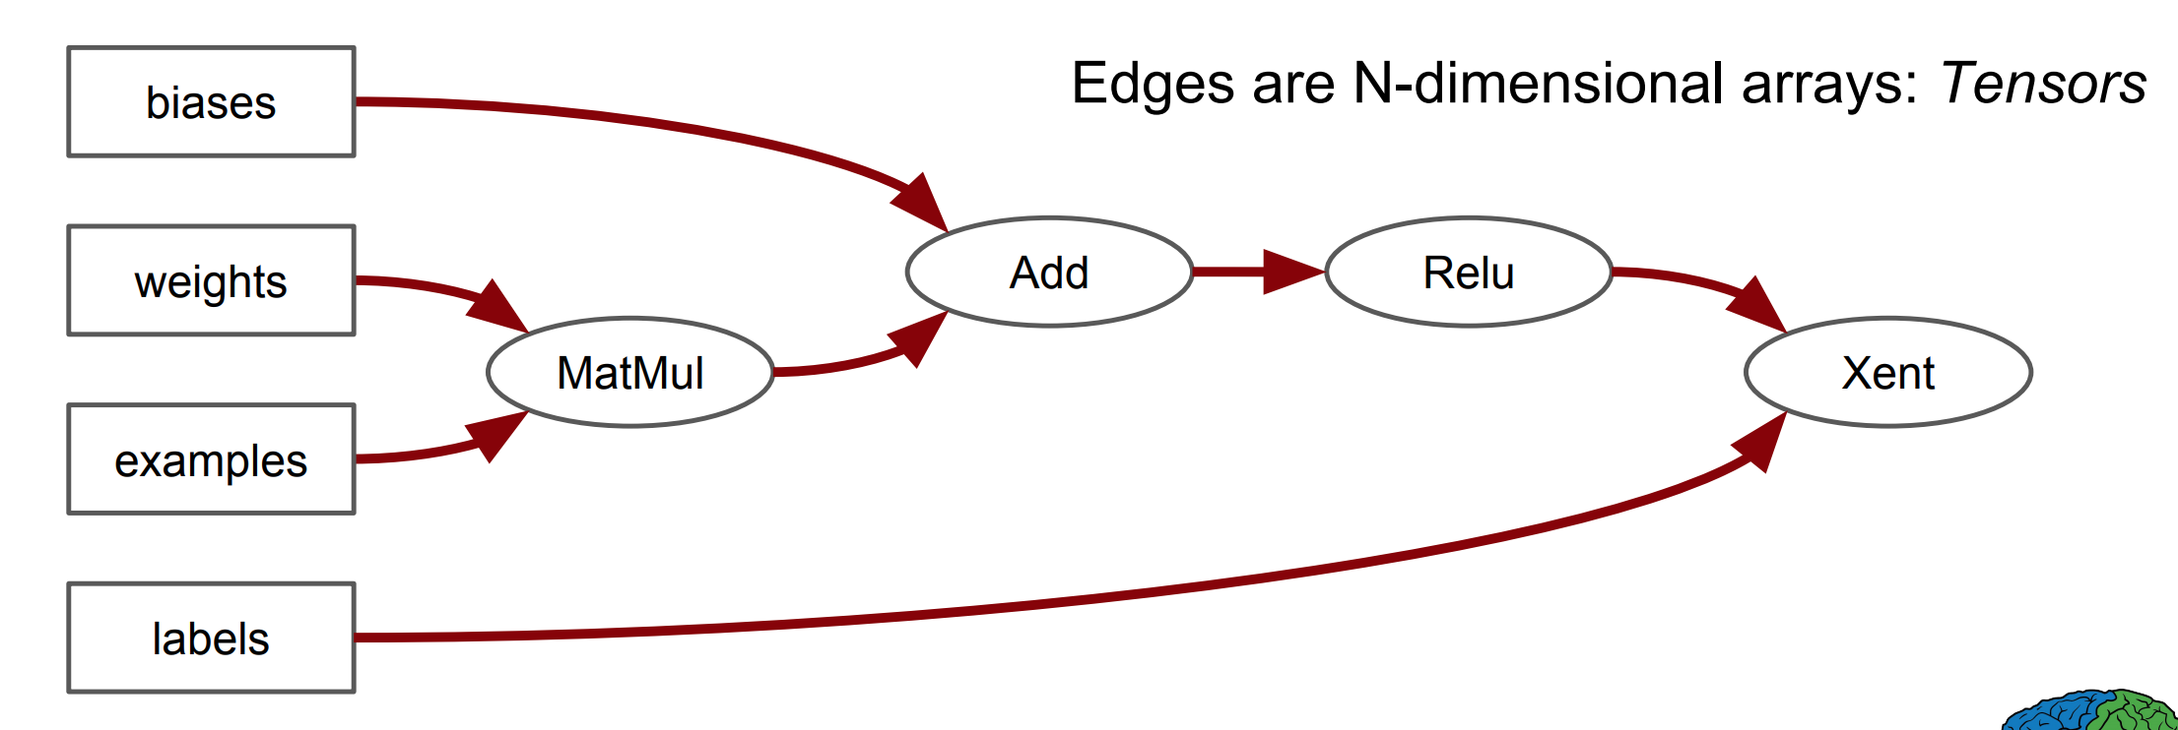
Dataflow Graph
Computation is a dataflow graph
Deep Learning Frameworks
Adapted from Jeff Dean “Large-Scale Deep Learning with Tensorflow”
Notes:
Refining: the interface for PS is not ideal for all optimization methods
Defining new training: simulator/emulator, adversarial networks, reinforcement learning

Slide 22
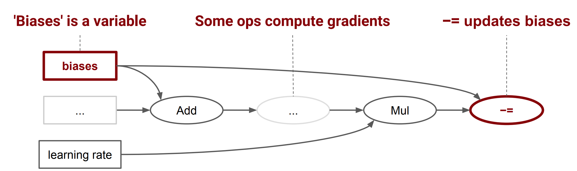
Dataflow Graph
Computation is a dataflow graph, with stateful operations
Deep Learning Frameworks
Adapted from Jeff Dean “Large-Scale Deep Learning with Tensorflow”
Notes:
Refining: the interface for PS is not ideal for all optimization methods
Defining new training: simulator/emulator, adversarial networks, reinforcement learning

Slide 23
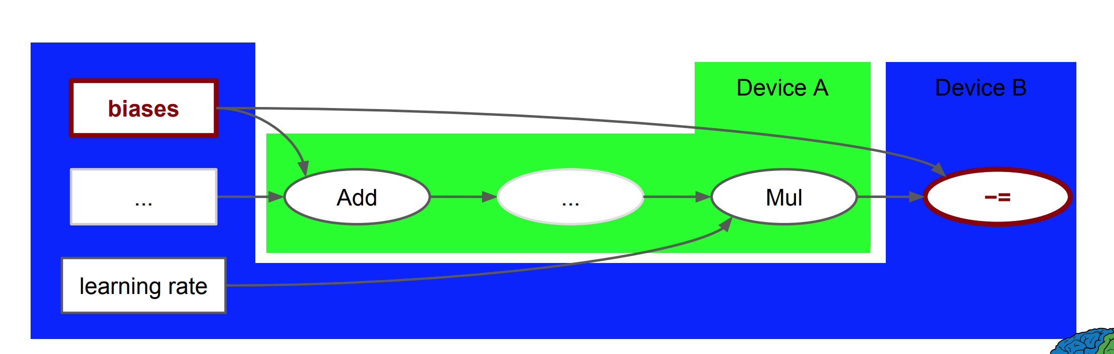
Dataflow Graph
Computation is a dataflow graph
Devices: Processes, Machines, GPUs, etc
Deep Learning Frameworks
Adapted from Jeff Dean “Large-Scale Deep Learning with Tensorflow”
Notes:
Refining: the interface for PS is not ideal for all optimization methods
Defining new training: simulator/emulator, adversarial networks, reinforcement learning

Slide 24
Execution Model
A single dataflow graph representing all computation and state
Explicit communication between subcomputations
Key differences from batch dataflow systems (MapReduce, Spark, etc.)
Multiple concurrent execution on overlapping subgraphs
Mutable state shared between different executions of the graph
Deep Learning Frameworks
Notes:
Explicit communication: Easy to parallel and partition

Slide 25
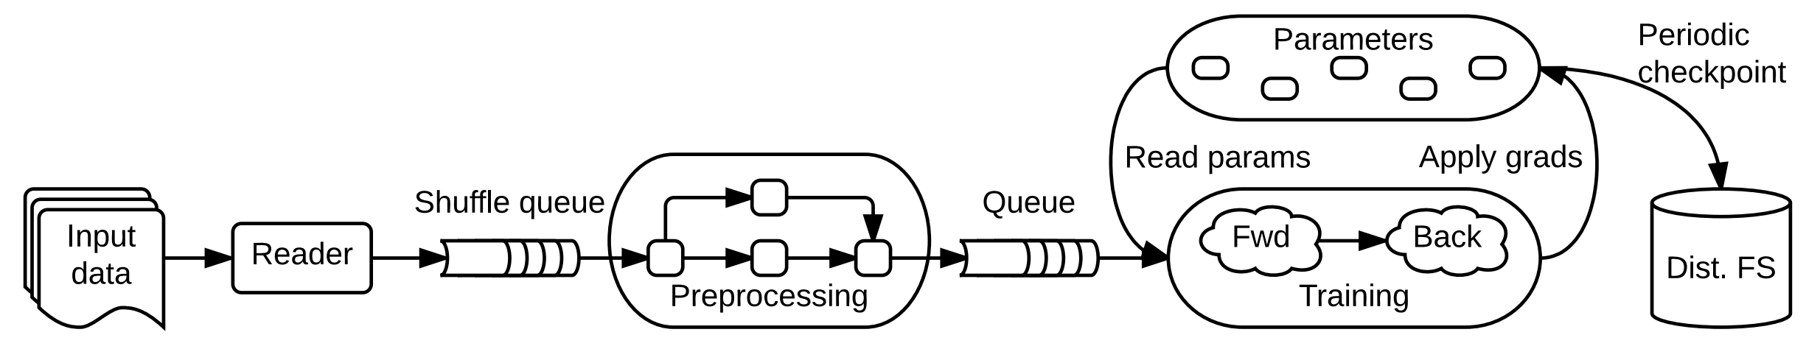
Partial and Concurrent Execution
A step: feed input tensors, fetch output tensors, compute necessary subgraph
Stateful operations allow steps to share data and synchronize when necessary
Flexible: a wide variety of model architecture -- async/sync
Deep Learning Frameworks
Notes:
Shows a typical training application, with multiple subgraphs that execute concurrently and interact through shared variables and queues. The core training subgraph depends on a set of model parameters and on input batches from a queue. Many concurrent steps of the training subgraph update the model based on different input batches, to implement data-parallel training. To fill the input queue, concurrent preprocessing steps transform individual input records and a separate IO subgraph reads records from a distributed file system. A checkpointing subgraph runs periodically for fault tolerance.

Slide 26
Distributed Execution
Each operation has an assigned Device
Kernels are device specific implementation of operations
Graph partitioned to per-device subgraph
Constraints
Colocation operations
Device preferences
Devices communicate with Send and Recv operations
Deep Learning Frameworks
Notes:
Explicit communication: Easy to parallel and partition

Slide 27
Dynamic Control Flow
Necessary as RNNs require control flow structures in the graph (e.g. if, loops)
Special operations: data dependent branching
Switch: demultiplexer
Merge: multiplexer
Dead values produced in Switch’s non-selected output, propagated until a Merge
Enter/Exit/NextIteration: loops
Deep Learning Frameworks
Notes:
Explicit communication: Easy to parallel and partition

Slide 28
Extensibility
Automatic differentiation
Optimization: dead code elimination, operation fusion, etc.
Sparse distributed matrix: Gather, Part, Stitch
Fault tolerance: user-level checkpointing
Synchronous replica coordination: avoid strugglers
Deep Learning Frameworks
Notes:
Explicit communication: Easy to parallel and partition

Slide 29
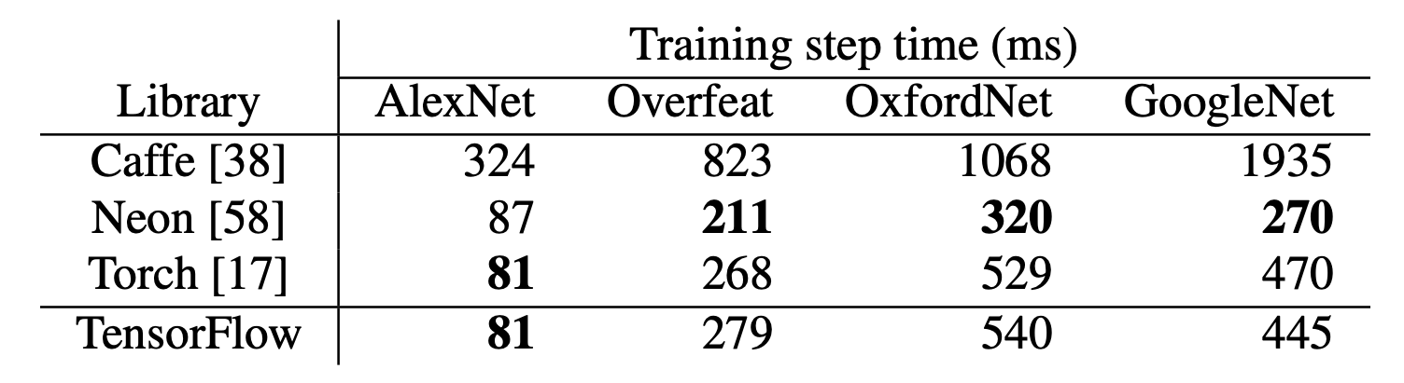
Evaluation
Single machine benchmarks
Deep Learning Frameworks
Notes:
Explicit communication: Easy to parallel and partition

Slide 30
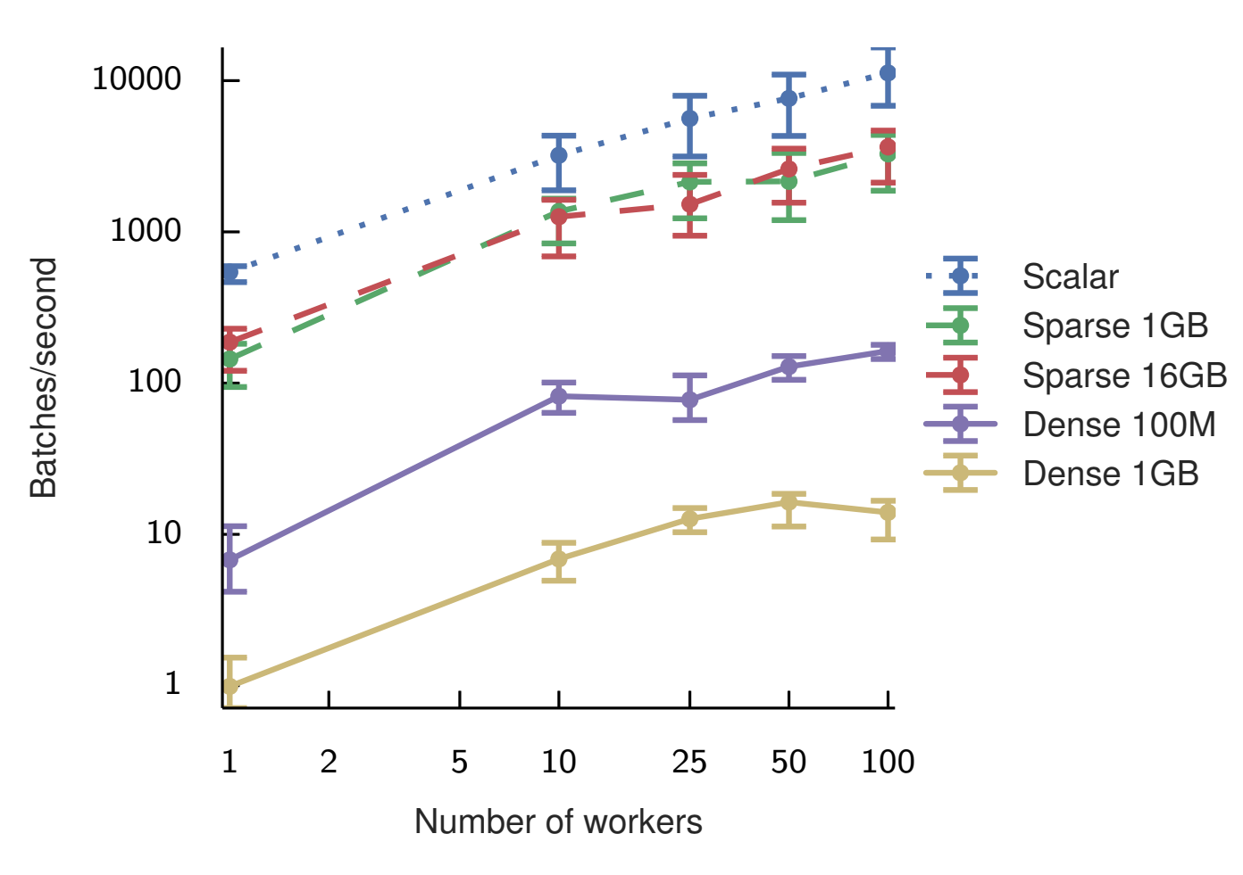
Evaluation
Baseline throughput for synchronous replication with a null model
Deep Learning Frameworks
Notes:
Explicit communication: Easy to parallel and partition

Slide 31
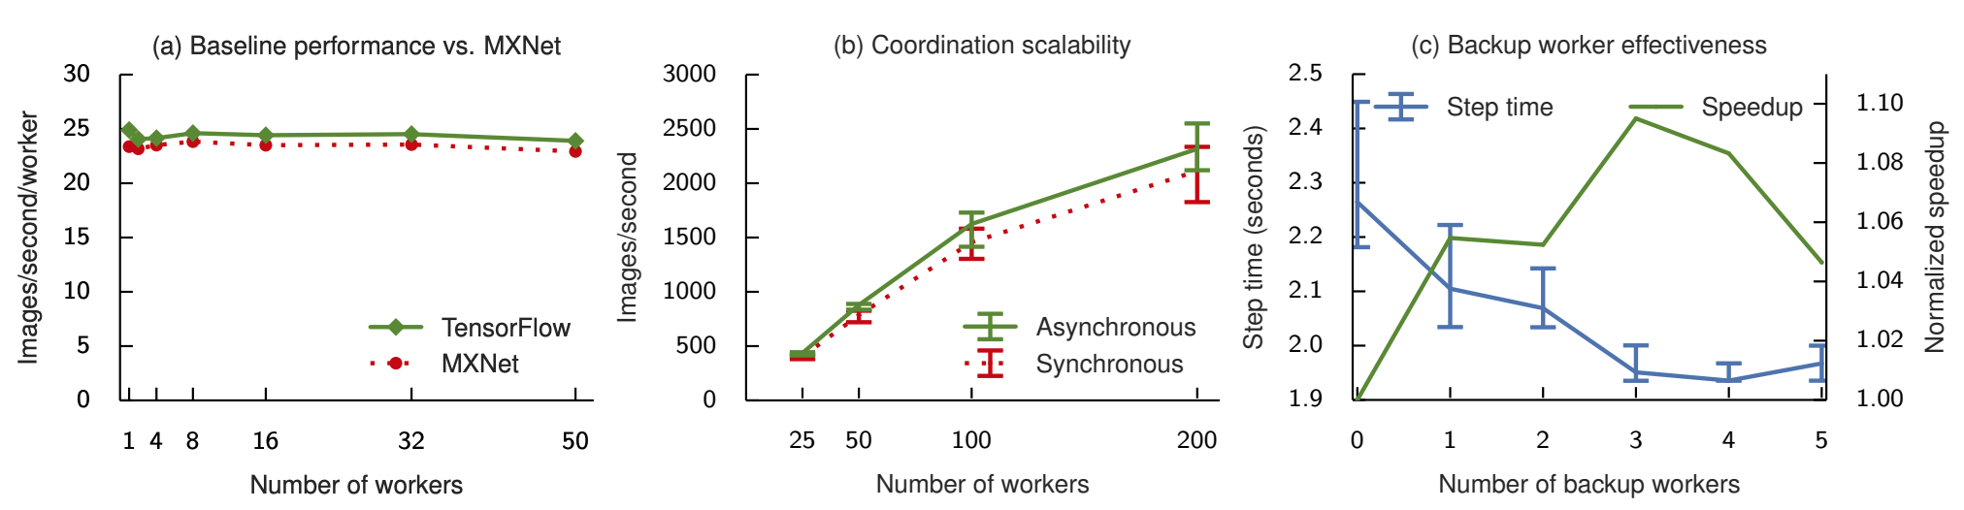
Evaluation
Performance evaluation for Inception-v3 training
Deep Learning Frameworks
Notes:
Explicit communication: Easy to parallel and partition

Slide 32
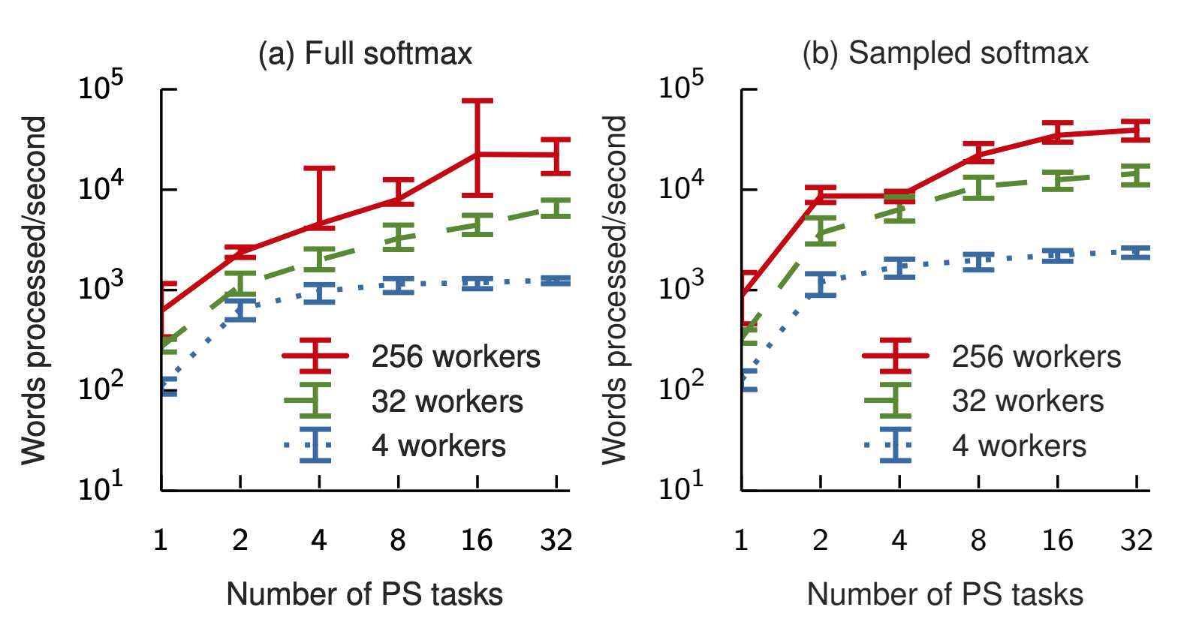
Evaluation
Single machine benchmarks
Deep Learning Frameworks
Notes:
Explicit communication: Easy to parallel and partition

Slide 33
TensorFlow
A unified framework for
Training
Serving
Researching
Supervised Learning
Ray as a distributed framework for Reinforcement Learning
Unification of
Training
Serving
Simulation
Deep Learning Frameworks
Notes:
Explicit communication: Easy to parallel and partition

Slide 34
Supervised to Reinforcement
Reinforcement learning (RL): learning to operate continuously within an uncertain environment based on delayed and limited feedback.
Learn a policy – a mapping from environment state to choices of action – that yields effective performance over time.
Three main capabilities of a RL framework
Simulation: explore different choices of action sequences
Distributed training: improve policy
Serve policy in closed-loop/open-loop control scenarios
Deep Learning Frameworks
Notes:
Explicit communication: Easy to parallel and partition

Slide 35
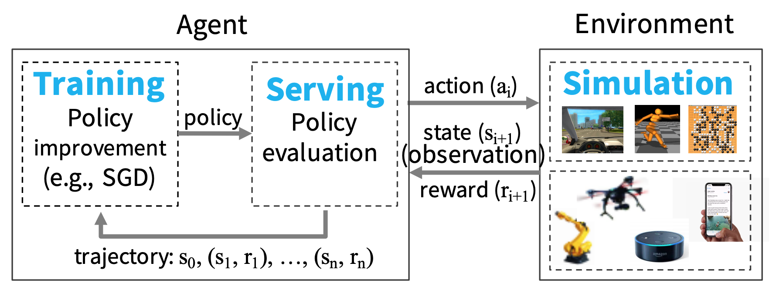
Requirement & Challenges
Fine-grained computations
Heterogeneity in time and resource
Dynamic execution
Bulk-synchronous parallel systems: no serving
Task-parallel systems: no distributed training and serving
Distributed DL frameworks: no simulation and serving
Model-serving systems: no training and simulation
Deep Learning Frameworks
Notes:
Explicit communication: Easy to parallel and partition

Slide 36
Ray: Programming Model
Future based API
Tasks: execution of a remote function on a stateless worker
Fine-grained load balancing: scheduled automatically on nodes
Support for object locality
High overhead for small updates
Efficient failure handling (pure functions)
Actors: stateful computation
Coarse-grained load balancing: runs on specified actor
Poor locality support
Low overhead for small updates
Overhead from checkpointing
Deep Learning Frameworks
Notes:
Explicit communication: Easy to parallel and partition

Slide 37
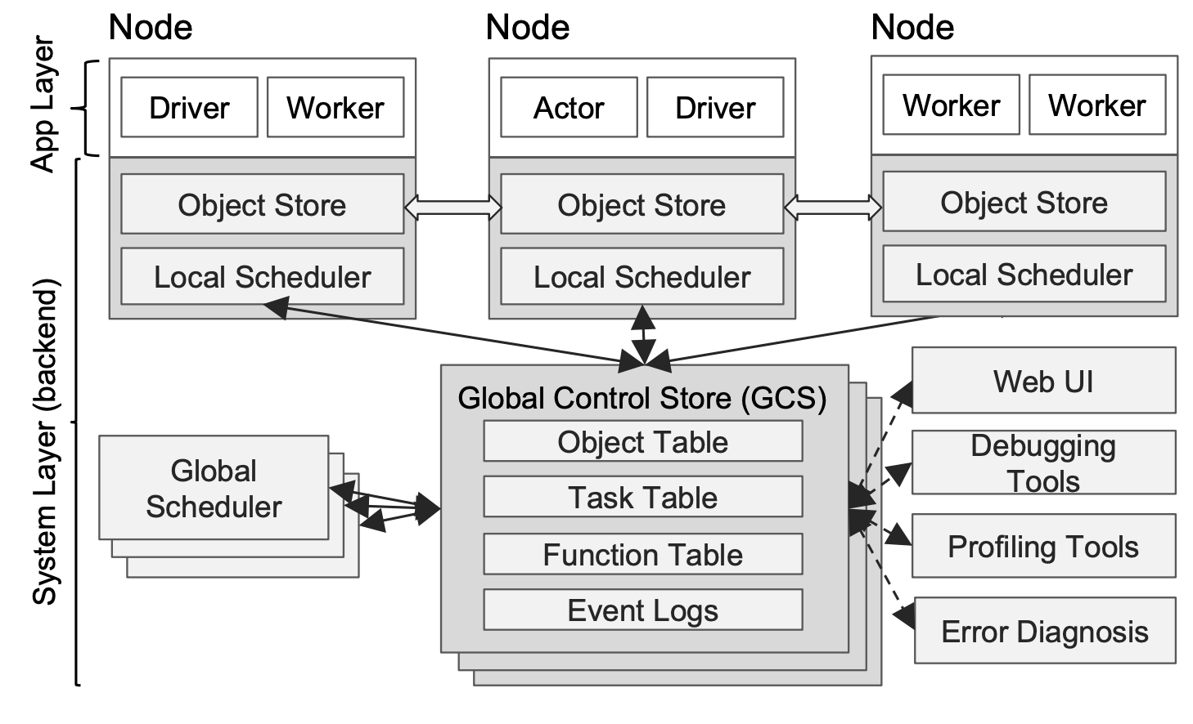
Ray: Architecture
Global Control State
Bottom-up distributed scheduler
In-memory distributed store
Deep Learning Frameworks
Notes:
Explicit communication: Easy to parallel and partition

Slide 38
Ray: Architecture
Global Control State
Entire control state
Key-value store with pub-sub functionality
Enable every component in the system to be stateless
Decouple durable lineage storage from other components
Deep Learning Frameworks
Notes:
Explicit communication: Easy to parallel and partition

Slide 39
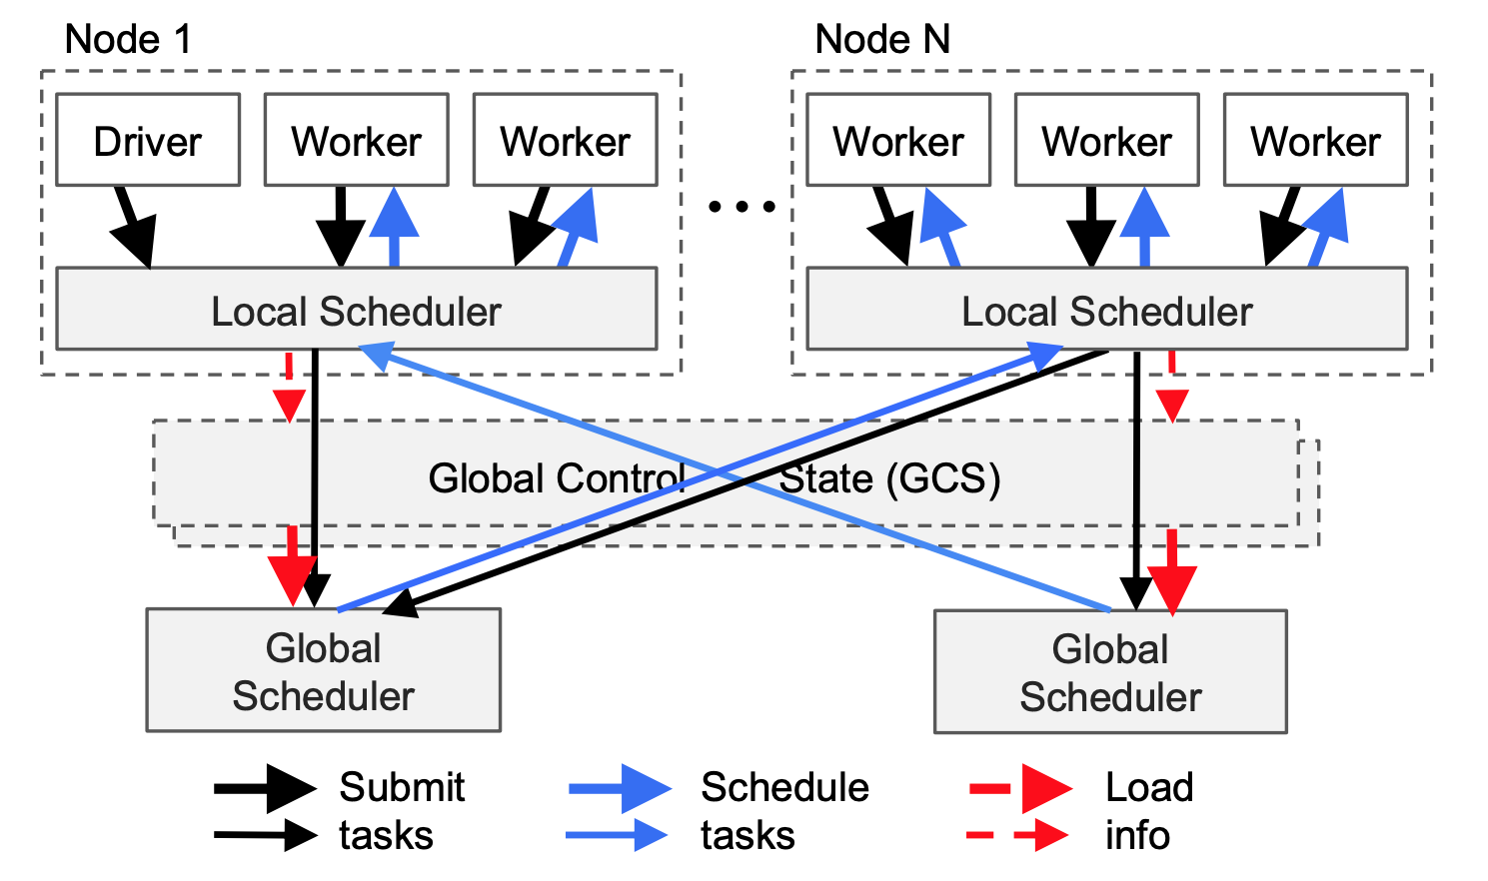
Ray: Architecture
Bottom-up distributed scheduler
Local scheduler first
Global scheduler
Estimate waiting time using heartbeat
Stateless, thus can be scaled by having more replicas
Deep Learning Frameworks
Notes:
Explicit communication: Easy to parallel and partition

Slide 40
Ray: Architecture
In-memory distributed object store
Store the inputs and outputs of every stateless computation
Nonlocal inputs are replicated before execution
Eviction using LRU
Immutable data only
Deep Learning Frameworks
Notes:
Explicit communication: Easy to parallel and partition

Slide 41
Discussion
TensorFlow
Better communication? RPC, RDMA, MPI, AllReduce
Auto-placement
Ray
Relationship to DL frameworks
Any drawback of GCS
Hierarchical scheduler
Deep Learning Frameworks
Notes:
Explicit communication: Easy to parallel and partition

